Slide 1
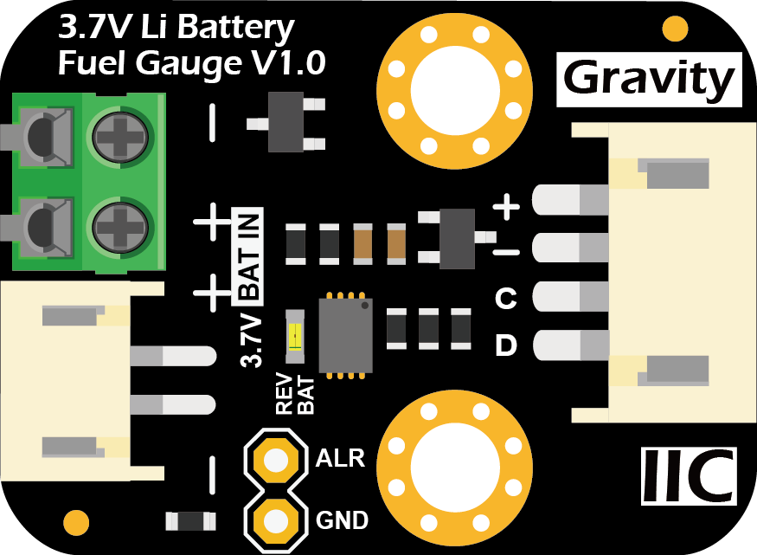

Type
C
USB 5V
LM386
IP5306
-
+
L9110S
LEFT
-
+
RIGHT
BACK
FRONT

